Slide 1
Fidelity National Financial
Marketshare Title Growth Partnership

Slide 2



Slide 3
Open Doors to Forward Living
Agent Count
Promises to FNF

Slide 4
Increase Title Market Share
Simple as A B C w TitleGenie
Providing Title Reps tools to open more doors and close more deals:
Attract Agents - With compelling conversation starters
Build Trust - by delivering pre listing presentations solutions they can’t live without
Close Deals - being “On the Listing Team” to get the title order before it hits MLS

Slide 5
Attraction of Agents + (I WILL GET SCREEN GRABS & Bullets)
TheGenie.ai
Title Genie Analytics
Market Share details
Insider Reports
Competition:
Broker Metrics
Altos
MyMTA

Slide 6
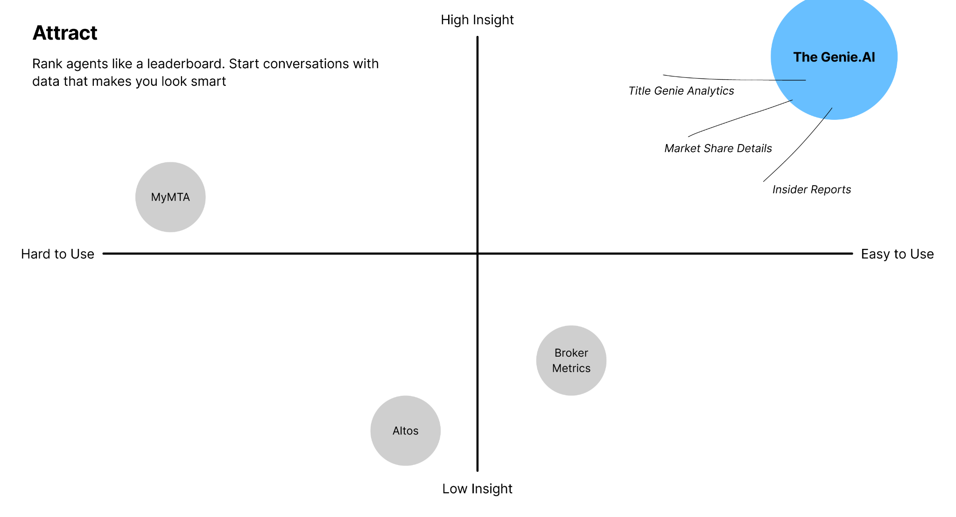

Slide 7
Build Trust + (I WILL GET SCREEN GRABS & Bullets)
TitleGenie + Paisley
Pre listing packages
GeoSocial Audiences
Automated Circle Prospecting
Competition:
TitleToolbox
Title24
Dynamic Farm

Slide 8
Agent Attraction
Build Trust

Slide 9
Close Deals + (I WILL GET SCREEN GRABS & Bullets)
We got this before the world knows
DONE DEAL
Competrition:
ZERO!

Slide 10
Agent Attraction
Build Trust
Close Tile Orders

Slide 11
F1 Vision
Lower transaction volume
Higher Title rep competition among the few winning realtors
Newer Realtors are less subscribed to the ‘relationship based’ model. Title business is transactional.
Many Realtors don’t close any deals. Title reps struggle to get conversations started with the few that do.

Slide 12
Increase Title Market Share
Simple as A B C w TitleGenie
Providing Title Reps tools to open more doors and close more deals:
Attract Agents - With compelling conversation starters
Build Trust - by delivering pre listing presentations solutions they can’t live without
Close Deals - being “On the Listing Team” to get the title order before it hits MLS

Slide 13
Attraction of Agents + (I WILL GET SCREEN GRABS & Bullets)
TheGenie.ai
Title Genie Analytics
Market Share details
Insider Reports
Competition:
Broker Metrics
Altos
MyMTA

Slide 15
Build Trust + (I WILL GET SCREEN GRABS & Bullets)
TitleGenie + Paisley
Pre listing packages
GeoSocial Audiences
Automated Circle Prospecting
Competition:
TitleToolbox
Title24
Dynamic Farm

Slide 16
Agent Attraction
Build Trust

Slide 17
Close Deals + (I WILL GET SCREEN GRABS & Bullets)
We got this before the world knows
DONE DEAL
Competrition:
ZERO!

Slide 18
Agent Attraction
Build Trust
Close Tile Orders

Slide 19
DEMO

Slide 20
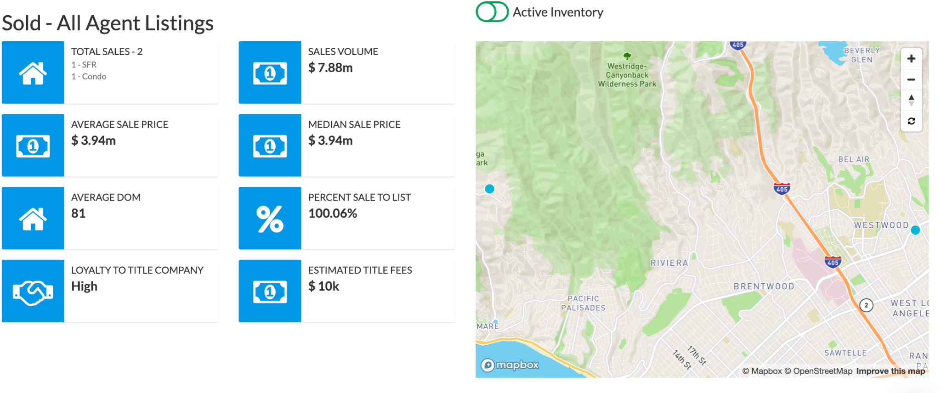
Don’t know which agents to target? Title Genie will tell you.

Slide 21
The bottom line?
Worthwhile Realtors want more than just check ins.
The best Realtors treat their business like a business. They only want to work with professionals that can legitimately help their business, not just ‘check in’.
They’re asking:
“What can you do to help me get listings?”
If a title rep can’t help with growth, they’re not getting their business.
<fix later

Slide 22
We empower Title Reps to:
Understand who to target:
Help Title Reps figure out which agents to target to do their business << compare to myMTA
Start conversations:
With statistics like how high Realtors rank against each other, playing to curiosity, urgency, and trust will help title reps start valuable conversations
Deliver instant value:
Give title reps powerful insights: farm data, velocity rates, and top listing zones & empower them with a platform that automatically acts on the data

Slide 23
And the best part?

Slide 24
***We need to figure out a way to explain the aircover**
Title reps are allowed to refer and recommend companies.
They are not allowed to give anything of value aside from their core product away.
Title reps are allowed to give agents a farm kit, but they’re not allowed to give them phone numbers and other types of data
Title genie: A TITLE BUSINESS DEVELOPMENT PLATFORM, not a Farming Tool, not a data slicer. >> we are the growth engine of title. Everything else is just a data delievery platform.
We have a limited number of seats in each area.

Slide 25
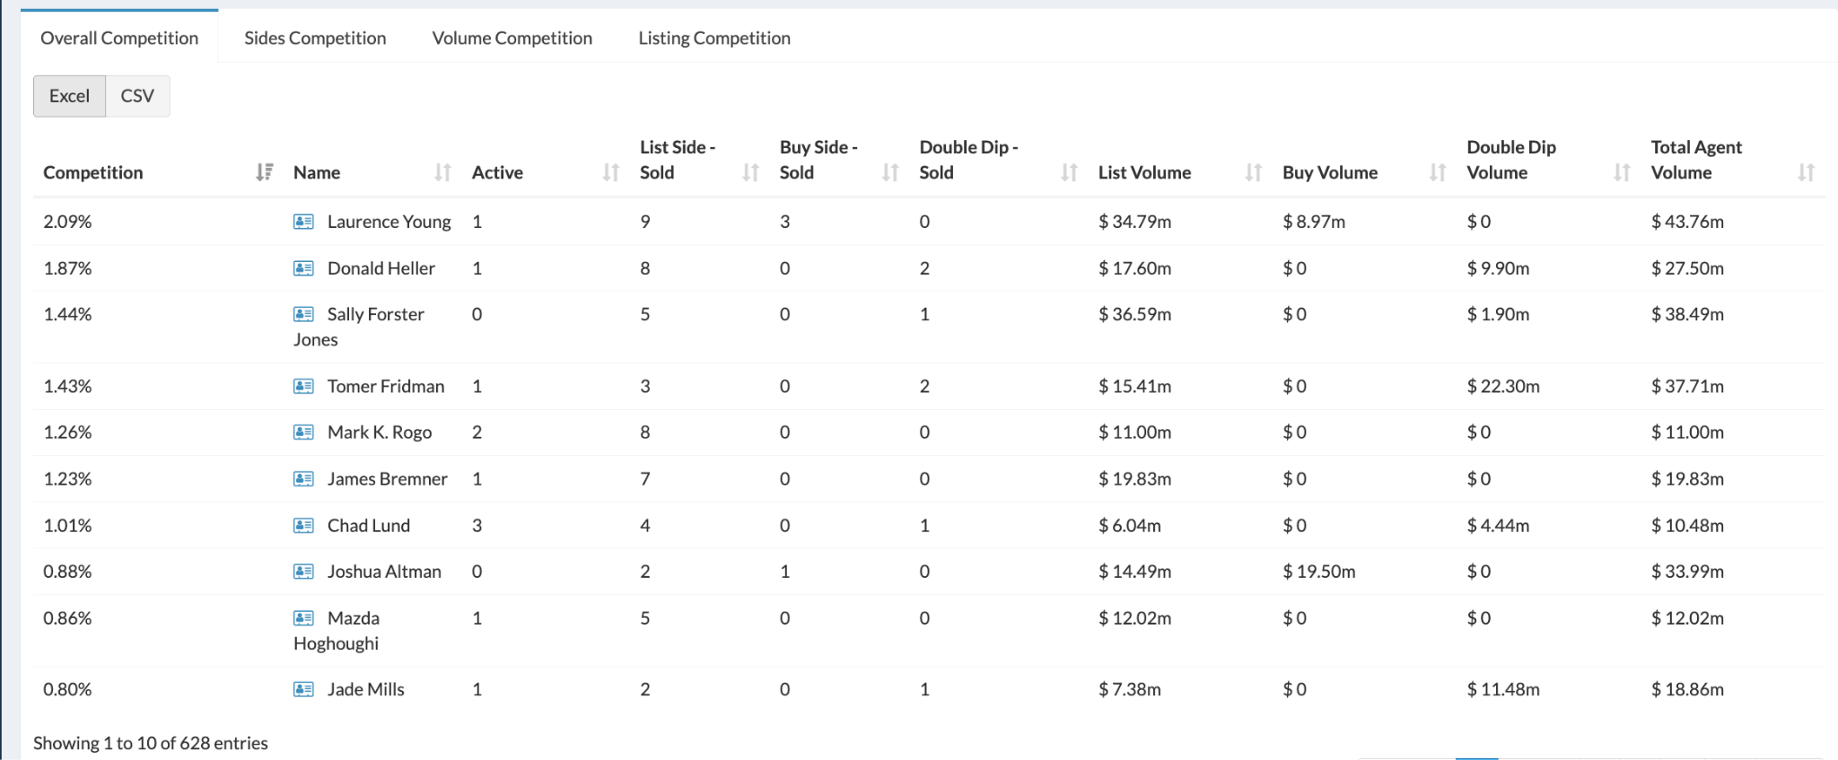
How’s “ever wondered how you compare to other Realtors?” as a conversation starter?
Realtors are the most competitive people in the world, and title genie is the only platform that has this data.

Slide 26
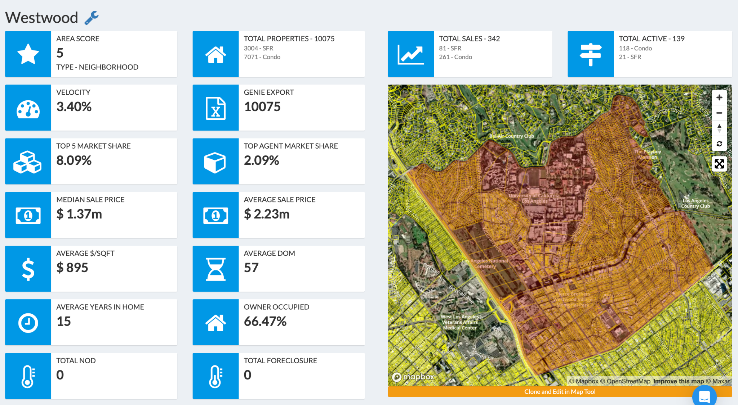
Our bread and butter: DATA
TitleGenie lets you analyze areas like a stock pick, nailing down exact strategies you can recommend to agents

Slide 27
Slides we need to add:
Selection - precision targeting of Realtors that we want to get business from
Connection - Using the selection to create conversations, differentiation by being able to provide value that elevates the value of the title rep

Slide 28
Our competition (Benutech) / our competitive advantage
Our analytical data is better, they are data brokers, we are business development people.
lwolf.com

Slide 29
Revolutionizing Title Sales
Provide Title Reps tools that make them (actually) valuable to Real Estate Agents by growing their listing business.
SH - Will rework this text

Slide 30
Testimonials from existing customers / data how title reps business increased

Slide 31
Getting Title Business is as easy as 1,2,3
Selection – choosing agents to work with, having hyper focus on which agents to work with, the target you are going after
Connection - we have the systems that allow the title rep to have the valuable conversations to create the connection
Commission - use our engine – get the title business before the listing even gets signed. Capture title on every listing by being in front of the listing. You become part of the listing team. You become a partner with the agent.

Slide 32
Keep it simple =
Selection, connection, commission
Currently - people are using a bunch of outdated and scattered tools. There is a lot of manual work between using these tools, most are run of the mill, and there isn’t really a way for title reps to differentiate themselves using a me-too product.

